Slide 1

Realizable Accessibility: Evaluating the Reliability of Public Transit Accessibility using High-resolution Real-time Data
Luyu Liu, Adam Porr, Harvey J. Miller
Department of Geography
The Ohio State University
(liu.6544@osu.edu, porr.4@osu.edu, miller.81@osu.edu)
2022/2/28

Slide 2
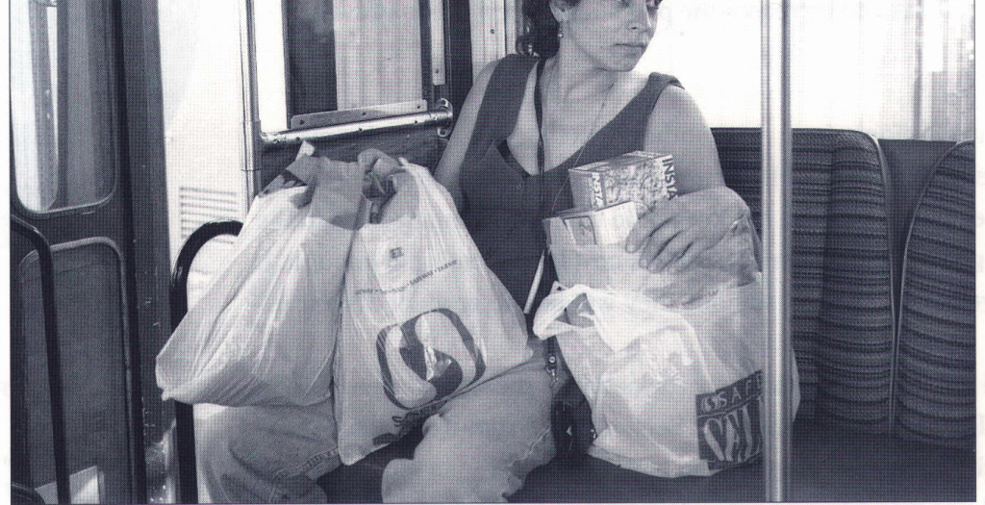
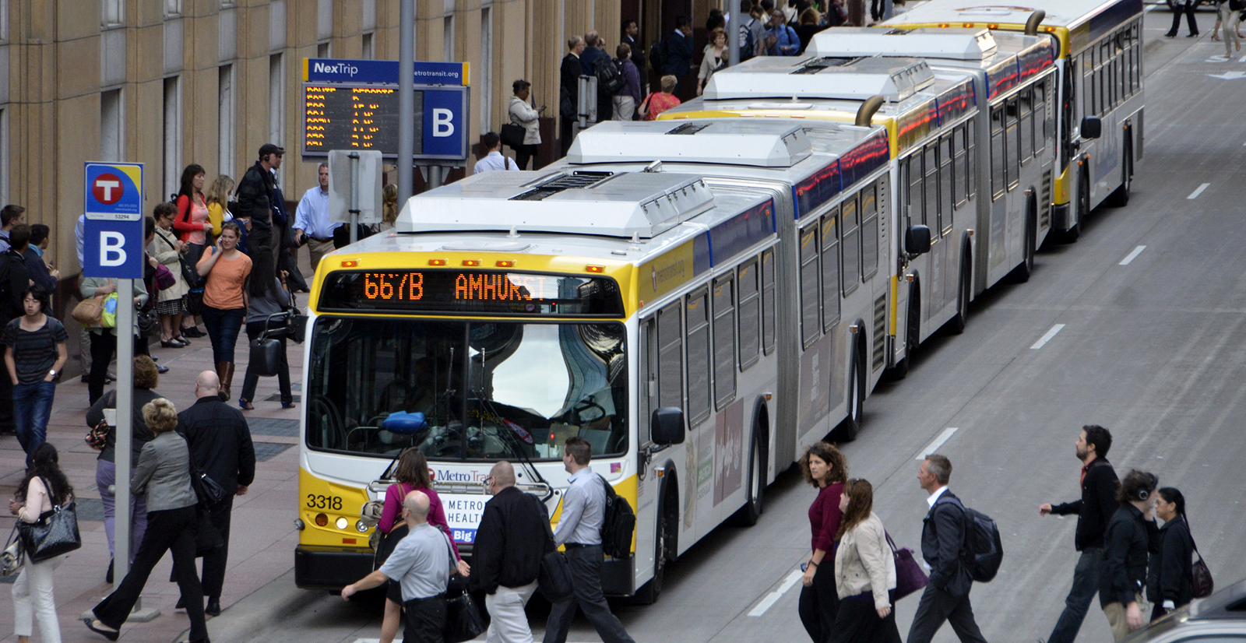

Accessibility and Public Transit
Accessibility is your ability to reach different places
Higher accessibility means more opportunities
Employments
Healthcare
Food
Accessibility via public transit can be limited due to limits on routes and schedules
Picture source

Slide 3
Evolution of Public Transit Accessibility
Early models are simplistic and static
Simple assumptions: e.g., walking accessibility to bus stops
Based on general system behavior: e.g., static headways
Accessibility is heterogeneous and dynamic
Varies with system performance and traveler's reactions
Bus-based systems are subject to external delays (e.g., traffic)
Better data, better measurements
High-resolution schedule: GTFS static
Large-volume real-time data: GTFS real-time

Slide 4
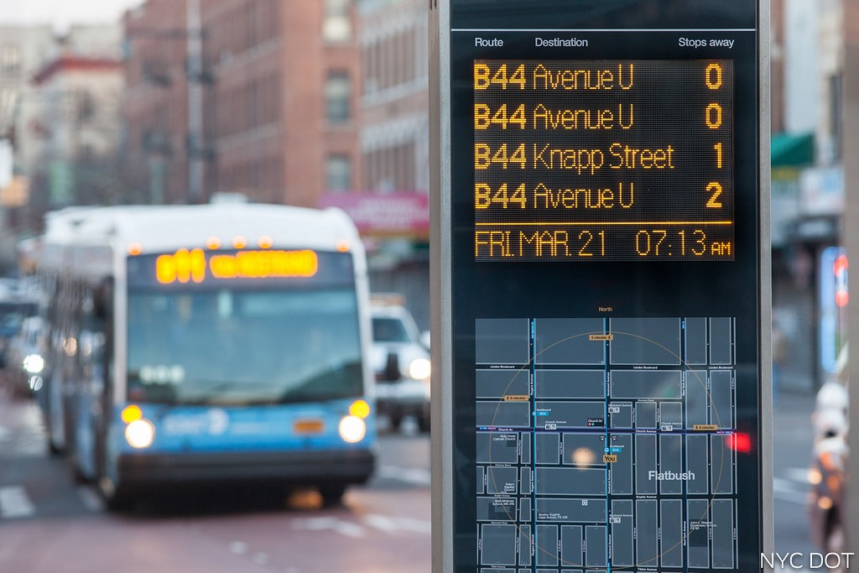
Accessibility and Scheduled Data
Most accessibility studies use scheduled data
Scheduled data is not reliable
Expected/scheduled time
Delay: traffic, weather, random disturbances
Real-time data is more reliable
Actual arrival time
What users experience
Source

Slide 5
Retrospective Accessibility
Retrospective real-time accessibility (Wessel, Allen, Farber (2017); Wessel and Farber (2019))
Retrospective: calculate accessibility based on historical actual arrival time
Very different from the scheduled-based accessibility
But it assumes clairvoyance or perfect real-time information
No one can tell buses’ actual arrival time before taking the bus
Some maneuvers are possible retrospectively, but passengers cannot foresee it
Like people playing a lottery knowing the winning number ahead of time

Slide 6
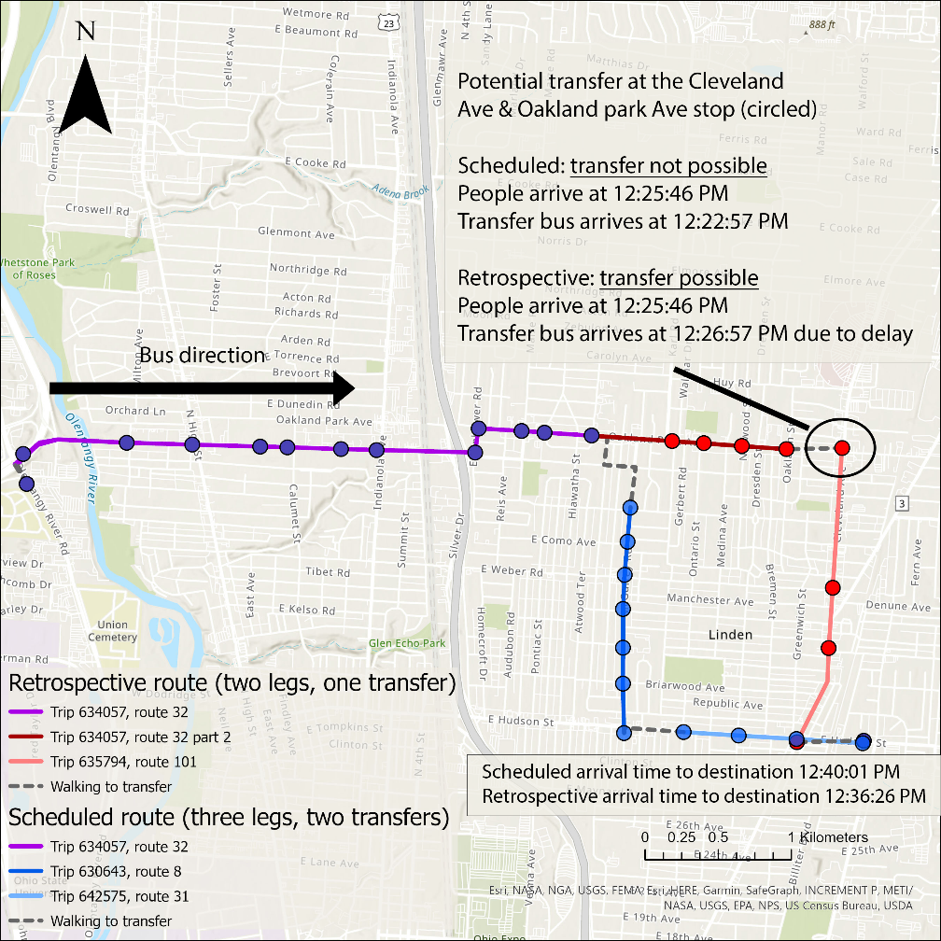
Example: Overestimation of Transfers
A formerly impossible transfer became possible due to a delayed receiving bus
But impossible to predict and implement for passengers traversing the system at that time
Example from GTFS data

Slide 7
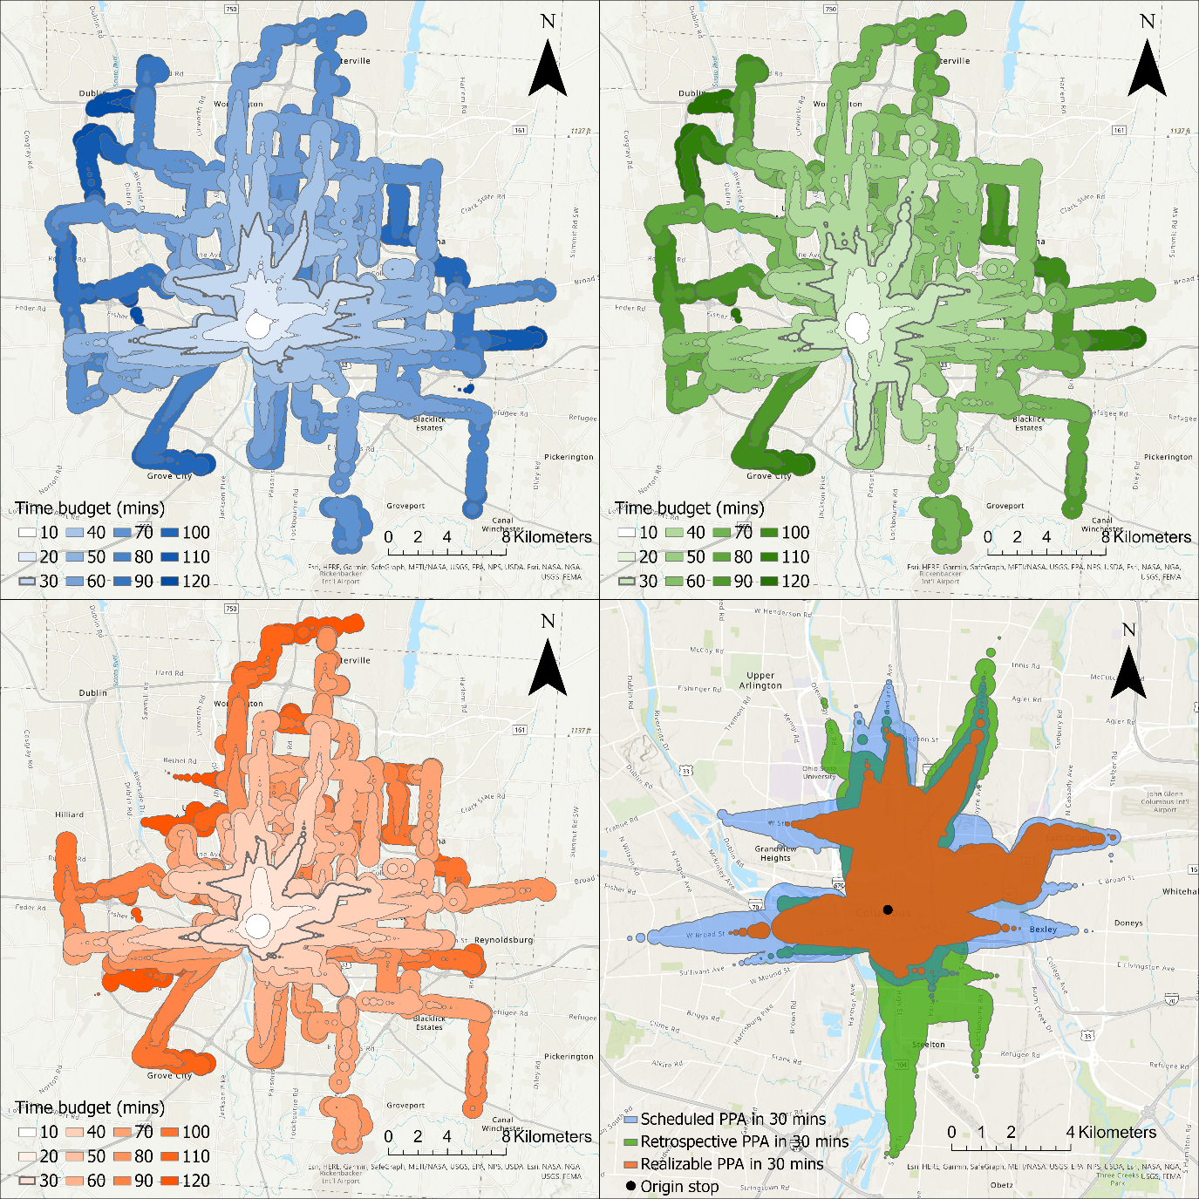
Realizable accessibility
Two step behavioral process
First plan with scheduled times from GTFS static, which are available beforehand.
Then implement with actual times from GTFS real-time data.
Just like humans do
More conservative
Example: realizable accessibility has smallest reachable area in 30 minutes

Slide 8
Three scenarios
Blue: scheduled, expectation from public authorities
Green: retrospective, overestimation
Orange: realizable, reality of passengers

Slide 9
How unreliable is public transit?
Unreliability: the difference between realizable and scheduled accessibility
Example: How far you can go from Columbus downtown in the real world (orange) versus in the schedule (blue) with different time budgets

Slide 10
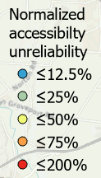
Does unreliability change over space?
Each point is a person trying to reach as far as possible
Color indicates unreliability
Blue: lower
Red: higher
For more practical time budget (15 – 30 minutes), accessibility in the city center is more unreliable

Slide 11
Spread of unreliability
Unreliability start from city center, spread to the suburban with higher time budget
Unreliability reaches saturation with long time budget
Downtown has low unreliability then
Because both scheduled and realizable can reach the city boundary
Does not mean overall unreliability is better

Slide 12
Conclusion
We often overestimate the accessibility generated by transit
We should be more conservative when measuring accessibility and planning transit systems
New high spatial and temporal resolution transit data makes this possible

Slide 13
Next steps
Investigate the implications of accessibility unreliability on actual planning and demand
Measure the impacts of real-time information
We only analyze following the schedule as users’ planning strategy
Users can also use real-time information
Unreliability analysis in more cities and public transit systems

Slide 14



Thank you!
Contact
Luyu Liu: liu.6544@osu.edu
Adam Porr: porr.4@osu.edu
Harvey Miller: miller.81@osu.edu
Center for Urban and Regional Analysis
cura.osu.edu

